Slide 1

Soccer Success Simulator
By: Jacob Hodges, Sam Ridderhoff, Anandhan Manoharan, Aidan Sherlock

Slide 2
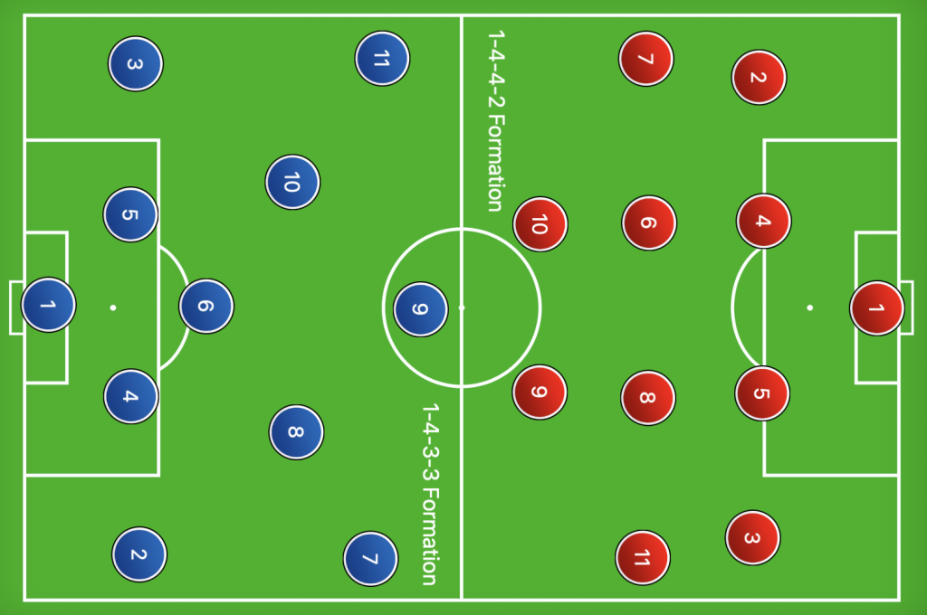
Introduction
11 players per team, 22 players on the field at once
Teams are allowed to replace players 3-5 times in a game (permanently)

Slide 3
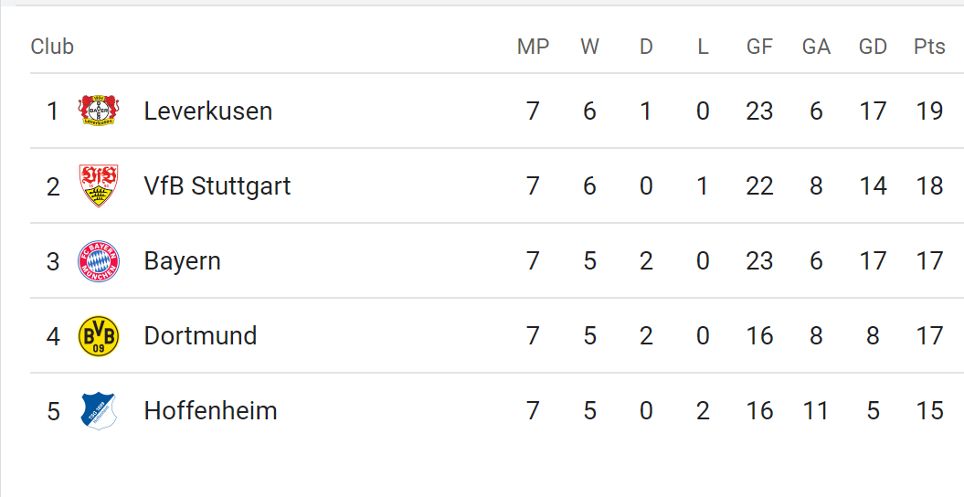
Introduction
Teams get 3 points for a win, 1 point for a draw, and 0 for a loss.

Slide 4

Introduction
There are no salary caps in european leagues, just very loose financial requirements.

Slide 5
Research Question
Can we predict a team’s final league position based on the number of goals they score/concede, how much money they spend, where they play, their average age, and their possession rate?
What is the relative impact of these variables against one another?
Should we focus on scoring goals or trying to stop the other team from scoring goals?
This kind of knowledge helps us with optimizing a teams strategy against their competitors.

Slide 6

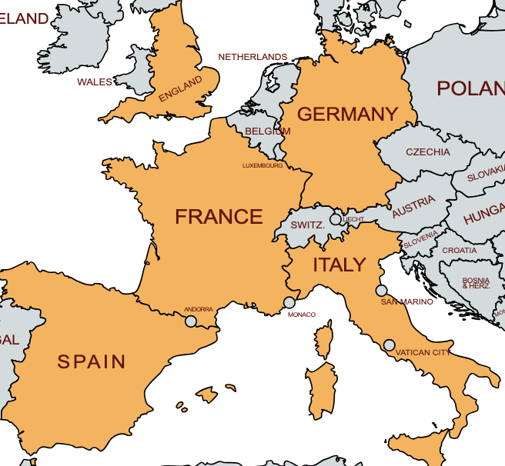
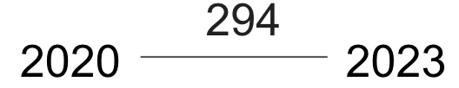
Data
Our Response Variable will be teams final league position.
Our explanatory variables include:
Goal Difference (how much many goals a teams scores minus how many goals they concede)
Expected and Actual Goals Scored and Conceded
Teams Weekly and Annual spending on Players Wages
The Average Age of a team
The team’s Average Possession (when they are in control of the ball).

Slide 7
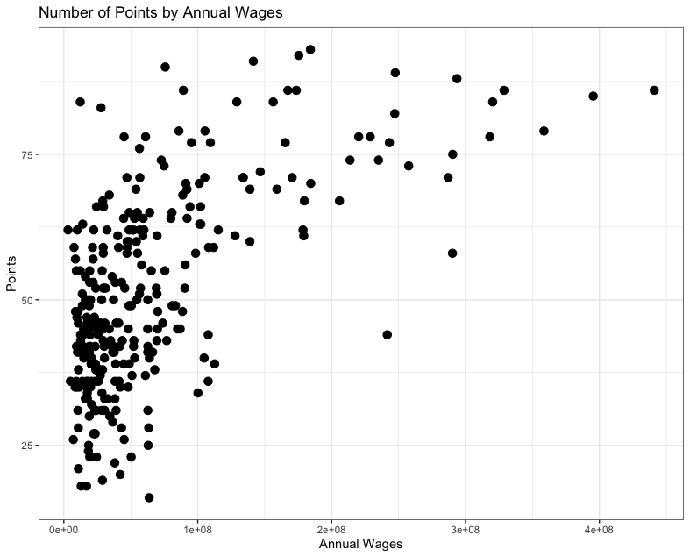
Exploratory Data Analysis
Scatterplot with the number of points a team has based on the amount spent on annual wages

Slide 8
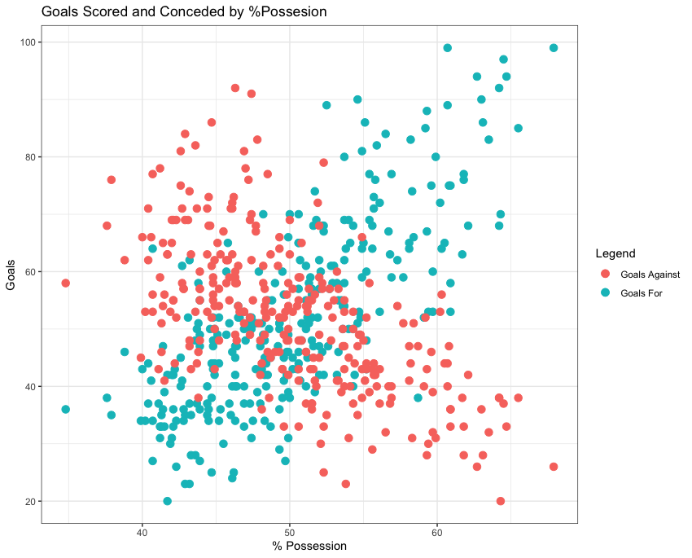
Exploratory Data Analysis
Goals for and goals against based on the teams amount of possession

Slide 9
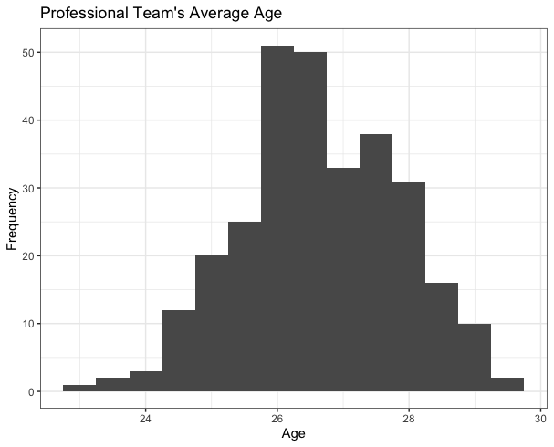
Exploratory Data Analysis
Histogram of the Teams Average Age

Slide 10

Regression Method
Ordinal Logistic Regression
Ordinal Logistic Regression is a method used to understand a relationship between a set of factors and an outcome.
Set of factors is our explanatory variables and outcome is an ordered categories which represents our dependent variable.
Trying to explain something ranked, in our case the standings of a club in the league table.

Slide 11
Ordinal Logistic Regression Assumptions
Dependent variable is ordered.
At least one predictor is continuous, ordinal, or categorical.
No Multicollinearity amongst predictors.
Proportional Odds.

Slide 12
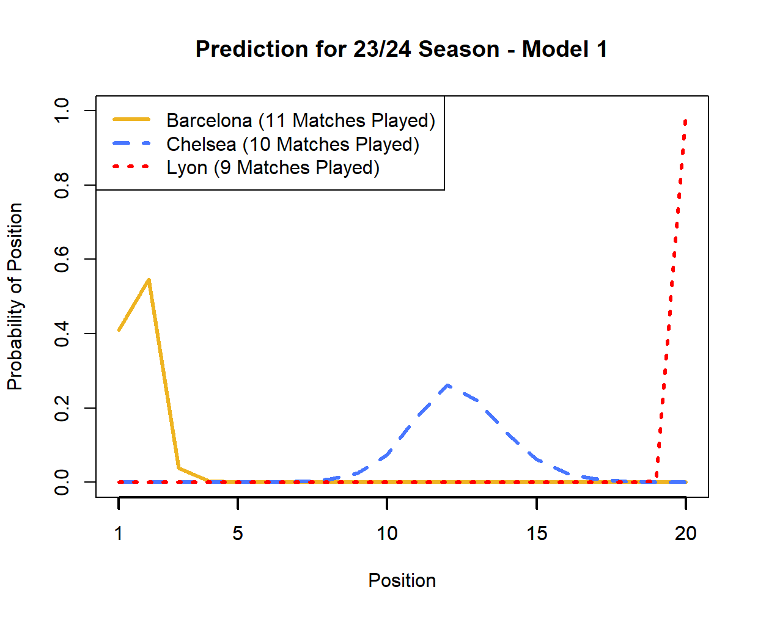
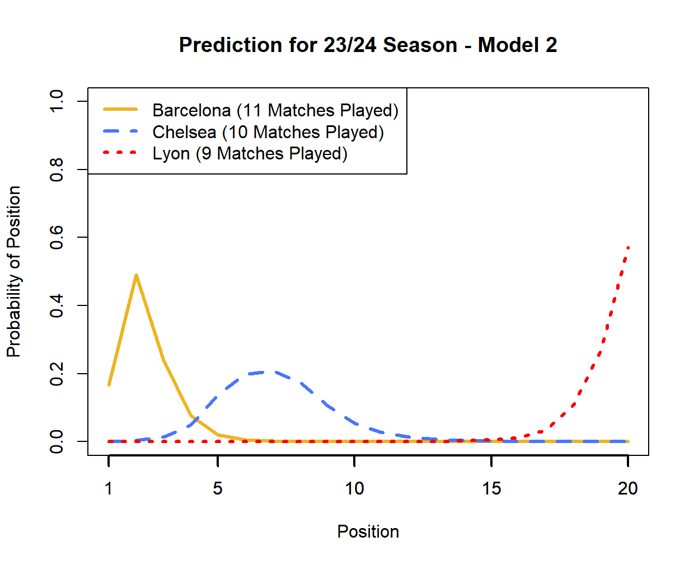
Preliminary Models
Model 1
Wins
Losses
Possession
Annual Wages
Expected Goals Against
Expected Goal Difference
Goals For
Model 2
Goal For
Goals Against
Possession
Age
Annual Wages

Slide 13
Assumptions - Model 1
Our dependent variable, position in the table, is ordered.
Annual Wages is a continuous variable, so at least one of our predictors is continuous.
The highest variance inflation factor was 4.12 for Expected Goal Difference. Using our Rule of Thumb, we can say this model passes the Multicollinearity assumption.
Running the Brant Test in R gave Wins, Expected Goals Allowed, and Possession as variables that could violate our proportional odds assumption.

Slide 14
Assumptions - Model 2
The highest variance inflation factor was 1.31 for Goals For. Using our Rule of Thumb, we can say this model passes the Multicollinearity assumption.
Running the Brant Test gave Goals For, Goals Against, and Age as variables that could violate our proportional odds assumption.
Notes:
Sample text

Slide 15
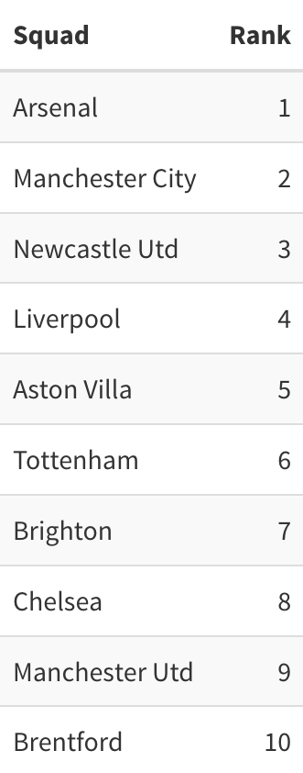
Conclusion
Move Forward with Model 2
Lower Highest Variance Inflation Factor
Simpler Model- 5 predictors vs. 7
What can we use our model for?
Take multiple years of prior data to predict the table for upcoming seasons
Make suggestions for team improvements; Should you spend more money, get younger, etc?

Slide 16
Questions?

